Slide 1
SCC211 Operation System
Zhang Jinyu – zjy@bjtu.edu.cn
School of Computer and Information Technology
SD408

Slide 2
Course Aims
Theory and practical application of operating system concepts and concurrent systems
General understanding of issues in writing concurrent systems
Understand the role of operating systems play in computing
Experience in designing and implementing complex data structures to meet resource and operational system constraints

Slide 3

Assessment
Programming & quiz based weekly
Feedback given in labs & office hours
More details on SCC211 Moodle page
Coursework deadlines is one month after the task is assigned.
Coursework is submitted online and plagiarism checked automatically

Slide 4
What is Plagiarism
Submitting someone else's code
Sharing code with each other
Paying someone else to do it for you
Working on assignment together & submitting individually
If you feel like it’s cheating, it probably is
We never caught anyone in the past, please don’t be first one!

Slide 5
What We Expect from You
Integrity and Effort
Come to lectures
Go to labs (they are compulsory)
Use textbooks and Internet
Take notes (it does help, promise)
Try to keep up with coursework and time yourself

Slide 6
What You can Expect from Us
Lecture notes on Moodle
Ensure labs are running smoothly and TAs are supportive
Provide extra support if needed
Offer prompt feedback on coursework
Respond to email

Slide 7

Nature of the module
Practical and theory
Lectures go hand-in-hand with the labs
Examples use multiple programming languages (C, Java)

Slide 8
Recommendations
Operating System Concepts, 7th edition: XP Version, James L. Peterson, Abraham Silberschatz, John Wiley & Sons Inc., ISBN: 0471262722 (any ed.)
Burns, A., and Davies, G., “Concurrent Programming”, Addison Wesley, 1993, ISBN 0-201-54417-2
Switzer, R., “Operating Systems: A Practical Approach”, Prentice Hall, 1993, ISBN 0-13-640152-X
Lea, D., “Concurrent Programming in Java”, Addison Wesley, 1997, ISBN 0201-69581-2
Stallings, W., “Operating Systems (4th edition), Prentice Hall, ISBN 0-130319996

Slide 9
Overview
Introduction/ context
Input and Output
Memory
File handling
Support for user applications
Multiple cores and virtualiz3ewation

Slide 10
Assessment
Coursework heavy module
Single exercise, remaining 30% of marks
Implement (subset of) real-world system
More realistic problem than typical exercises
Given specification and ‘blank sheet of paper’
Implementation language: Java
Submit week 9, marking sessions week 10
To be fair to everyone, you will only be marked in your allocated session

Slide 11
Different type of problem than perhaps used to
About developing confidence as much as anything
Basic solution not difficult, but…
Might need to catch up on coding/ problem solving skills
Will need time to think about it
There are plenty of subtleties, gotchas, …
Start NOW!!!
Don't leave it or you won't complete it
Or enjoy it! …many do, eventually ;
Past students report helped with FYP

Slide 12
SO WHAT IS AN OPERATING SYSTEM? SO WHAT IS AN OPERATING SYSTEM? SO WHAT IS AN OPERATING SYSTEM?

Slide 13
Operating System Operating System
Machine does little without one, OS…
Manages hardware and system resources
Shares out and accounts for resources
Offers secure environment for applications
Provides common device or I/O system
Includes kernel and system library interface
Don’t consider *
Applications and services
Desktop environment

Slide 14
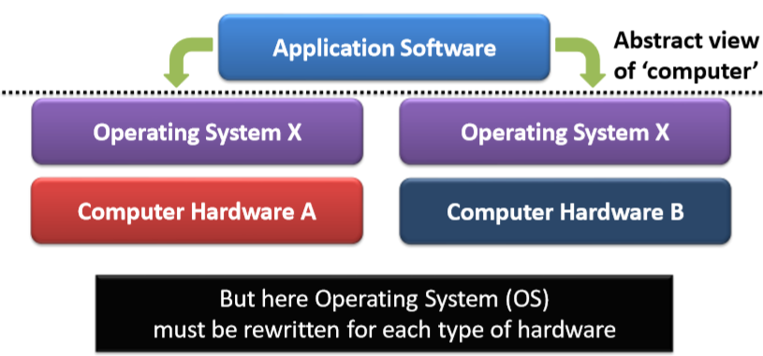
Benefit of Abstraction
Operating System gives known abstract environment within which application can operate

Slide 15
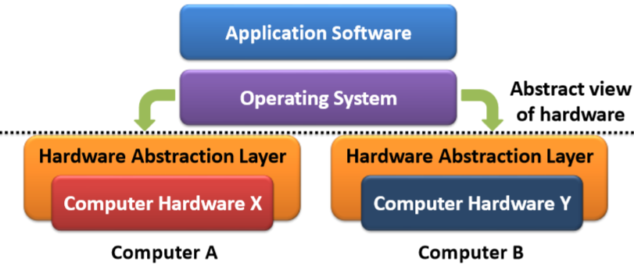
Benefit of Abstraction
Hardware abstraction allows us to hide hardware differences from Operating System
Operating System can then run on different hardware

Slide 16
Operating Systems
Embedded/ Real-Time, emphasis on
Proven long term reliability and strict timing guarantees
Small footprint, no unnecessary code
Certification process for safety critical systems
• Server, emphasis on
Fairly sharing resources
Reliability
• Desktop, emphasis on
Interactivity
GUI and graphics/ media
Could be same OS running with different parameters

Slide 17
Operating Systems
There are many, but…
Unix and (Windows) NT
Dominate market
Have huge application and support base
User view driven by graphical interface
Arguably not part of OS
Can be quite different to underlying OS
Not necessarily where we’d start from today

Slide 18
EVOLUTION OF A PLATFORM
Windows and the Intel x86 Architecture have a long and shared history

Slide 19
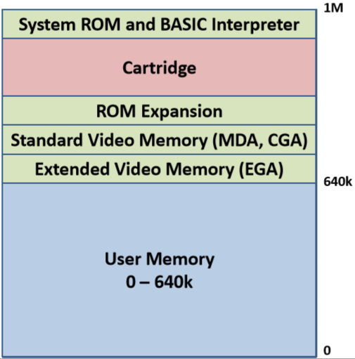
Early PC Memory

Slide 20

PC-DOS and MS-DOs
Based on earlier CP/M by Digital Research
Control Program for Microcomputers(CP/M) – then for 8080, Z80
Written in PL/M and Assembly Language
DOS designed within limits of 8086/ PC architecture
All code equal, no protection
Written in Assembly Language
Shipped as PC-DOS with IBM PCs
Provided module/ driver support
Rarely used, most code wrote directly to hardware
Still available for people running legacy code
Core functionality also available through Command Prompt.

Slide 21
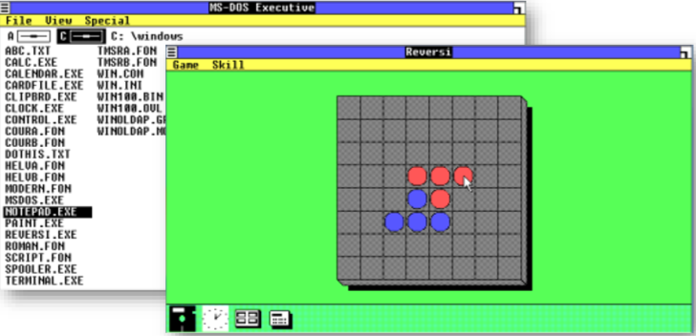
Nov. 1985: Windows 1.0 Premium
Non-overlapping ‘Windows’
Each full-scree app. Runs full-screen
ALT-TAB
ALT-ENTER
Serial mouse

Slide 22
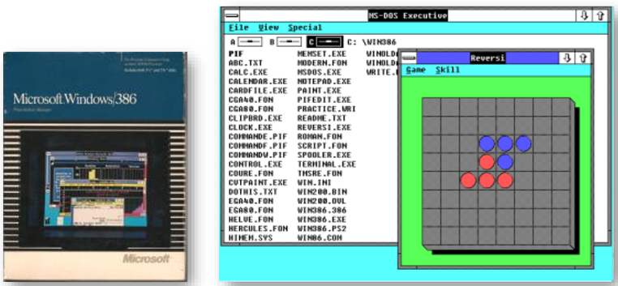
Dec 1987: Windows 2.11 Windows/286 or Windows/386
Overlapping windows + PS/2 mouse support
Intel 286 or 386 with Extended Memory driver
3.25” floppies

Slide 23
Backward Compatibility
Extra memory available with Intel 80286
Memory no longer wrapped at 1MByte
– Address line 20 (A20) now addressed above 1M
– Spare keyboard controller line used to hold A20 low
Allowed old code to see wrapped memory until released
Modern PC based OSs must still emulate this hack
– Typically performed by bootloader during boot
– x86 starts in ‘legacy’ mode or old code wouldn’t run

Slide 24
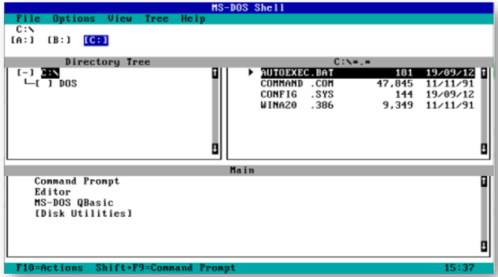
MS-DOS 5.0
Menu driven interface
– Command prompt still available

Slide 25
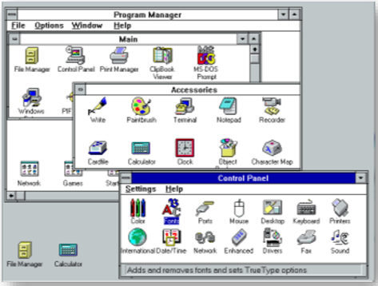
Windows 3.1
Later Windows for Workgroups 3.11
Added network based file and printer sharing
1990: Win 3.0
1992: Win 3.1
Virtual Memory and
later Internet support

Slide 26
July 1993: Windows-NT
32 bit OS independent of MS-DOS
Born out of OS/2 collaboration with IBM
Coalesce MS Windows, MS Unix, and OS/2
Multiple personalities
Remained a separate code base until Win XP
NT for workstations, DOS for home/ small office PCs
NT Server and NT Workstation editions
Determine runtime operation – decided during install

Slide 27
TYPES OF OPERATING SYSTEM

Slide 28
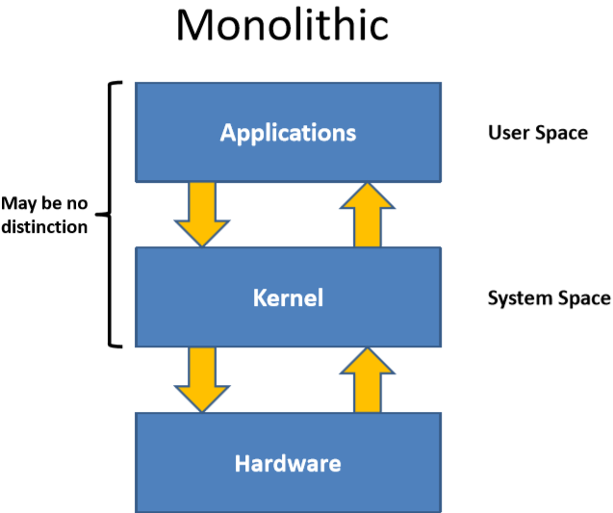
Monolithic

Slide 29
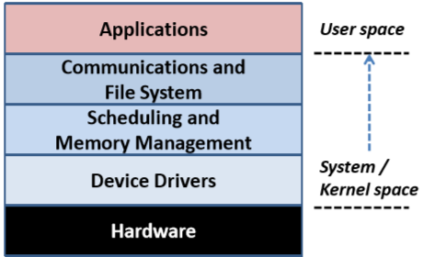
Monolithic
Traditional approach
– Tight coupling of non-application code
At most two protection levels (system and user)

Slide 30
Monolithic
All OS code running with full privileges
– In some systems may not be distinct user/ system levels
Difficult to impose security or protection
Efficient call structure
– Shared access to resources
Difficult to maintain
– Code boundaries frequently blurred
Example:
Embedded OSs, DOS based MS Windows, initially Linux

Slide 31
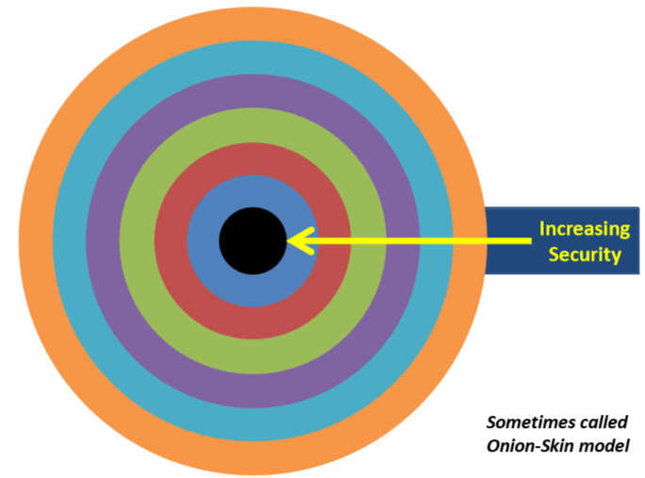
Monolithic

Slide 32
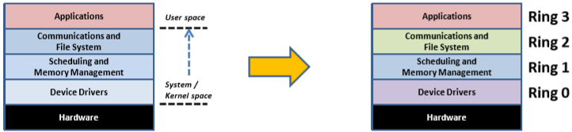
Layered Approach
Realization that we have identifiable layers in system
High-level components built on lower ones
Impose tighter security as move from hardware
Performance penalty with every layer crossed
Hard to manage if complex inter-layer call chain
Can’t call up layers (only down) so needs thought at design stage

Slide 33
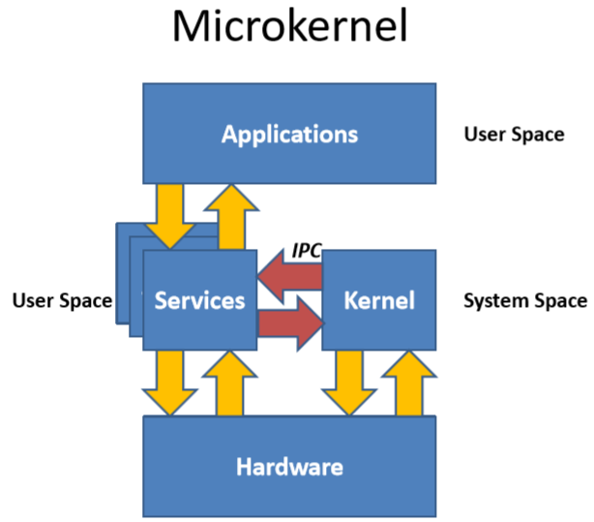
Microkernel

Slide 34
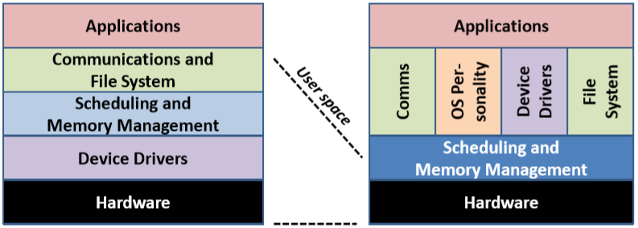
Monolithic vs. Microkernel OS
Far less code running with elevated privileges
Most code subject to security constraints

Slide 35
Micro-Kernel
Minimal amount of code has ‘system’ privileges
Most code in unprivileged ‘user space’
Far more secure than other approaches
Components communicate by message passing
Main function of kernel in this model is
Inter-Process Communication (IPC)
Can be inefficient
Most real implementations break model (hybrid approach)
Extensible and have minimal system dependencies
Clean APIs make porting or extending OS much easier
Example
Mach, Minix, initially Microsoft (Windows) NT

Slide 36
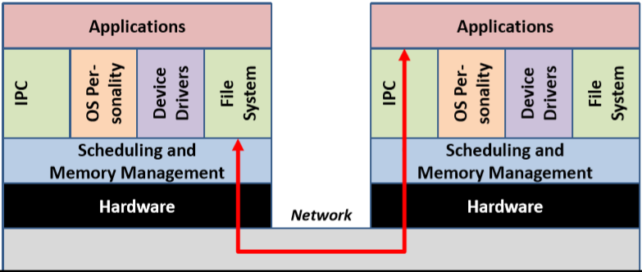
Networked Microkernel OS
Microkernels Inter-Process Communication based
Easy to extend over network (with performance penalty)

Slide 37
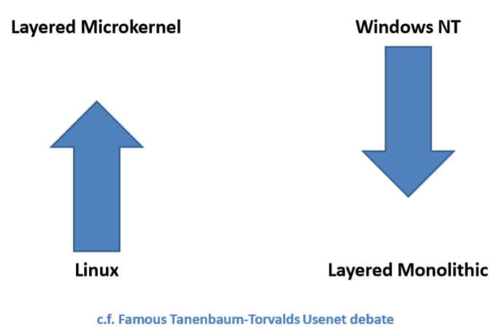
Relative Evolution of NT and Linus

Slide 38
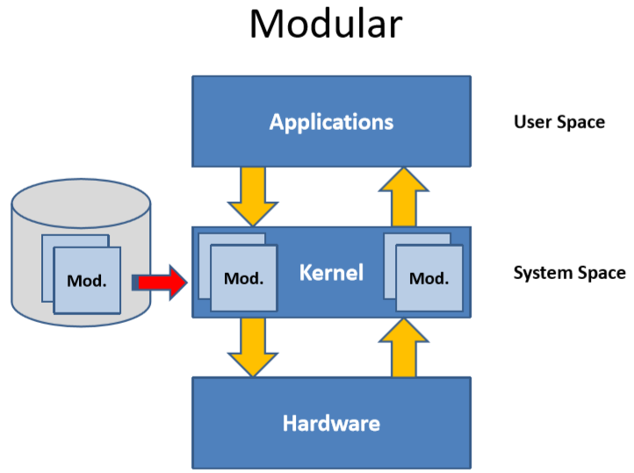
Modular

Slide 39
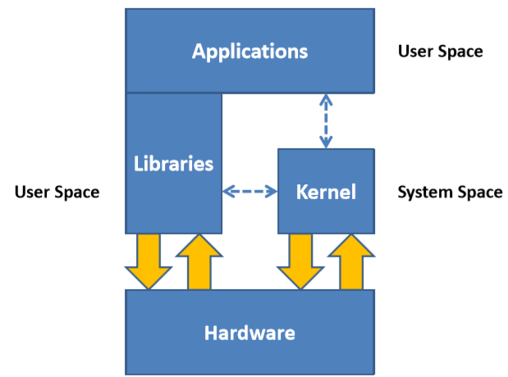
Library OS/ Uni-Kernel

Slide 40
Library OSs and Uni-kernels
Kernel configures security at lowest level
Disk blocks, for example
Libraries provide
Additional (user-/ resource-centric) security
OS Structure and personality
Could have Linux and Windows libraries on same system
Applications more aware of hardware
OS personality bound into each application via libraries
Can better match hardware constraints, features, …
Less consistency in applications, APIs, etc.
Microsoft have demonstrated a fairly complete Library-OS re-implementation of Windows 7

Slide 41
WHEN YOU HAVE TO USE ASSEMBLY LANGUAGE…

Slide 42
C or Assembly Language?
C can be used for most code
Advantage of systems language
Max ~10% assembly language, typically a lot less
Setting up environment for C code
C has minimal requirements so relatively easy
Calling kernel, kmain( )
Accessing anything non-standard
Special CPU registers
CPU interrupt system
Special instructions
» e.g. for isolated (as opposed to memory mapped) I/O

Slide 43
Question？

